Slide 1
Community Profiling and Metagenomics
Anitha Sundararajan Ph.D.
Johnny Sena, Ph.D.

Slide 2
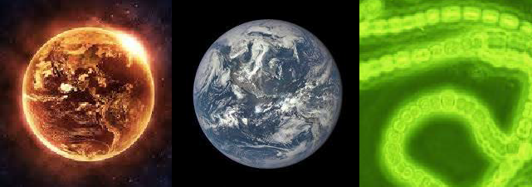
Microbes were the first life forms on this planet
Earth declares its independence about 4600 MYA
First photosynthetic bacteria 3.4 billion years ago (BYA)
Used sunlight for energy to create biomass
Anaerobic (anoxic photosynthesis)
2.7 BYA first oxygen producers emerge
Oxygen as waste product during respiration
Most of the oxygen was sequestered and not readily available

Slide 3
Microbes were the first life forms on this planet
2.3 BYA atmosphere has oxygen
500 million year ago (MYA) first terrestrial plants
200 MYA mammals emerged
13 MYA one of us makes all of us proud by learning how to fly
10 MYA the branch of life currently called homo emerges
400 years ago humans observe the first microbe under a simple scope
THERE WOULD BE NO LIFE WITHOUT MICROBES

Slide 4
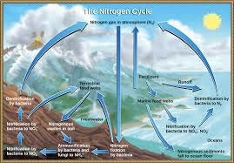
Microbes enable habitability on Earth by catalyzing reactions of biogeochemical cycles
The amount or % of elements on Earth remains constant
Recycling of these elements, flux and bioavailability is largely taken care of by microbes
Best example to illustrate – nitrogen
78% of Earths atm is N2
Required for important biological processes
In gaseous form it is unavailable
In fact many processes are N2 limited
Making N2 bioavailable in a form that can be by eukaryotes is completely on the shoulders of microbes

Slide 5
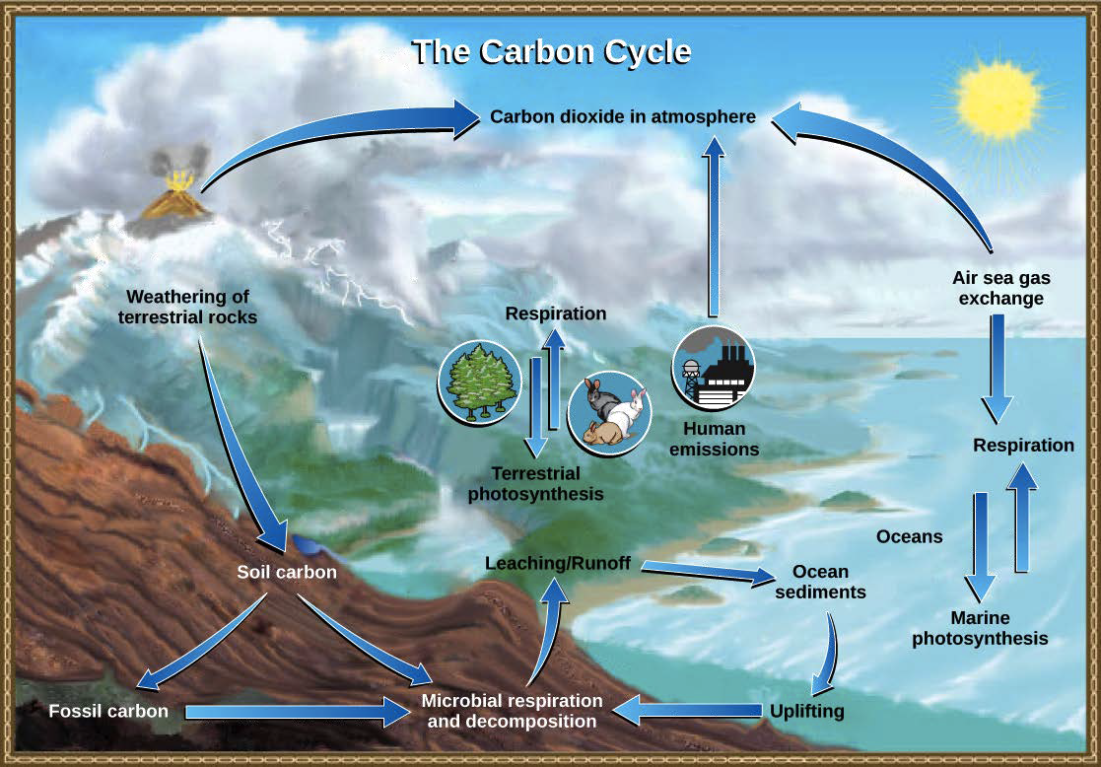
Carbon Cycle
- 4GT
+9GT
-3GT
-2GT

Slide 6
How many microbes!
40 million microbes in a gram of soil
One million microbes in a ml of fresh water
One trillion in a human body
MICROBES ARE ABUNDANT……AND EXTREMELY DIVERSE!

Slide 7
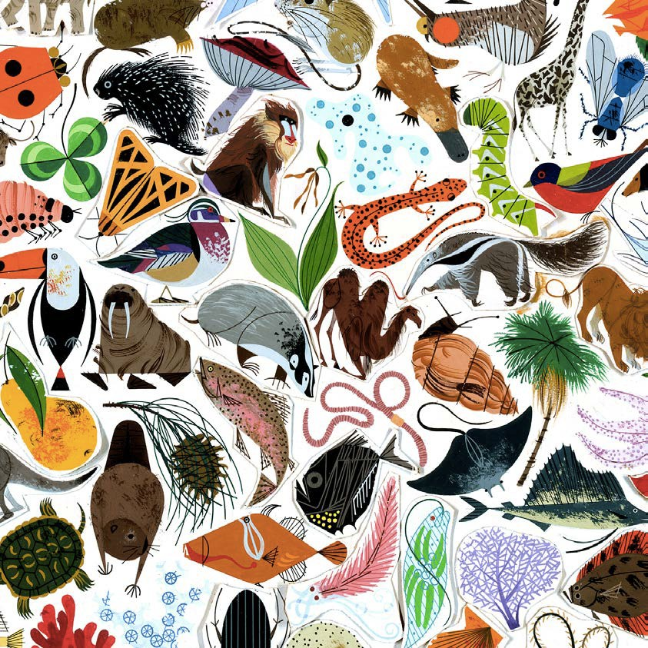
How many kinds of living beings are there?

Slide 8
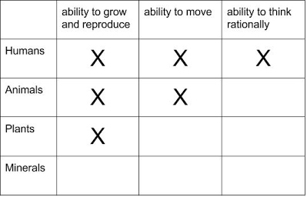
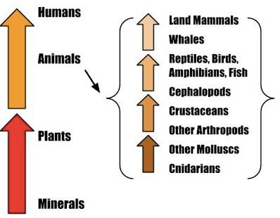
Aristotle’s Scala naturae – 350 BC

Slide 9
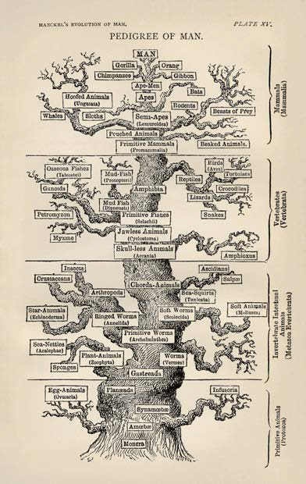
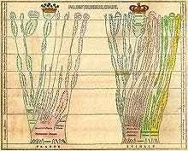
2000 years later,
1840, Edward Hitchcock
Ernst Haeckel, 1879

Slide 10
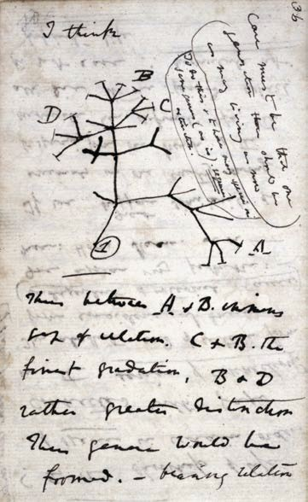
Around the same time,
The idea that species could have evolved from an ancestor
This could have happened through transmutations
Premise for trees today
ALL METHODS DEPEND ON OBSERVABLE MORPHOLOGICAL TRAITS FOR CATEGORIZATION
Charles Darwin, 1837

Slide 11
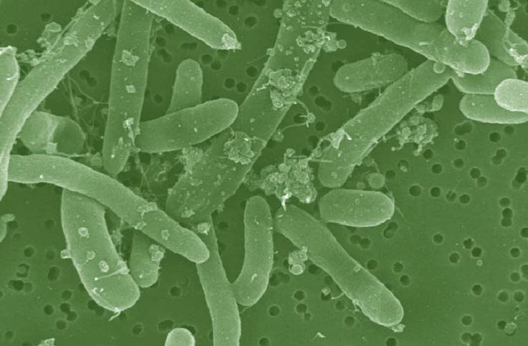
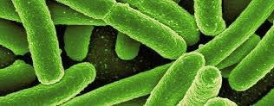
What happened when we found out about microbes?
Image by Manfred Auer

Slide 12
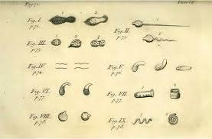
Roadmap to where we are now with determining microbial diversity
Site to microscope
Leeuwenhoek, Father of microbiology, late 1600’s

Slide 13
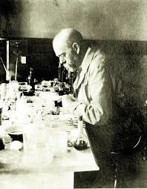
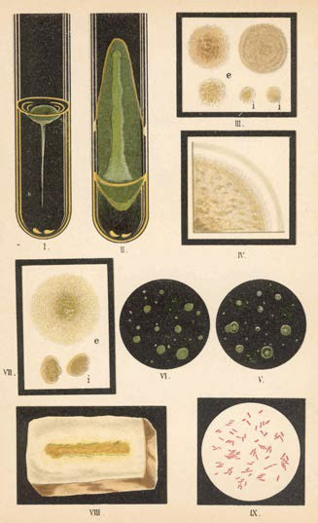
First time bringing microbes to lab
Robert Koch, 1890
Cultivation

Slide 14
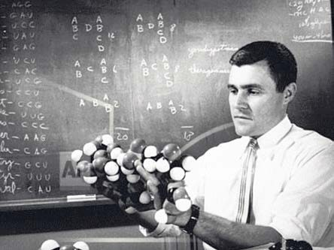
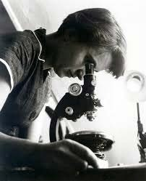
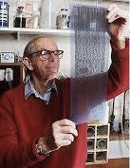
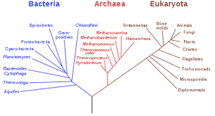
Discovery of structure of DNA
Carl Woese, 1977
Frederick Sanger, 1975
Rosiland Franklin, 1951

Slide 15
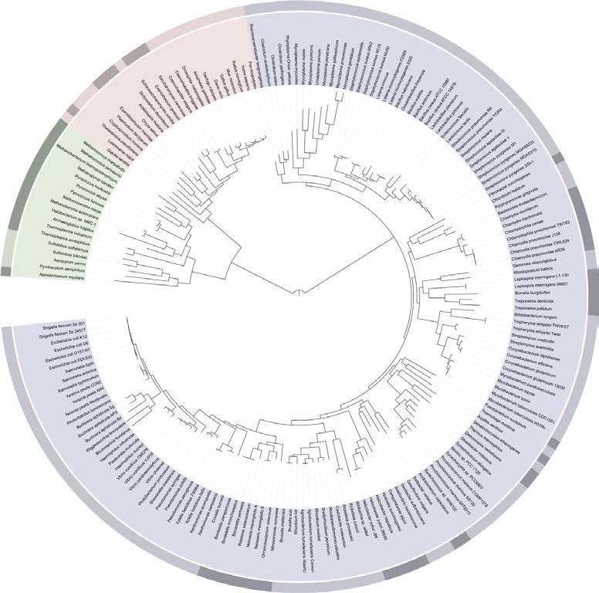
Tree of Life
Eukarya
Archaea
Letunic 2006

Slide 16
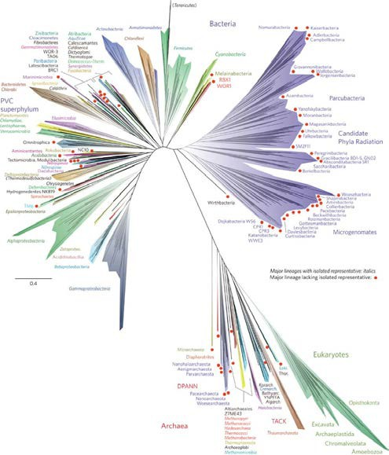
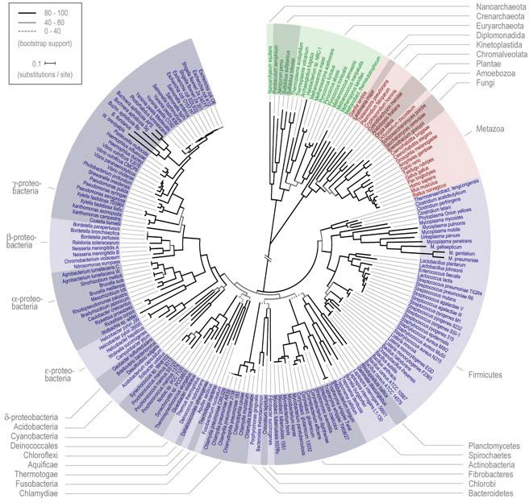
Tree of Life……..just got weird!
Science, 2006
Nature Microbiology, 2016
“Visible organisms represent the smallest sliver of life’s diversity. Bacteria are the true lords of the world. They have been on this planet for billions of years and have irrevocably changed it, while diversifying into endless forms most wonderful and most beautiful.”(The Atlantic)

Slide 17
What makes microbes so special?
-15ºC/4ºF to 130ºC/266ºF temperatures
0 to 12.8 pH acidity
More than 200 atm pressure
4 miles deep into Earth’s crust
Up to 5kGy radiation

Slide 18
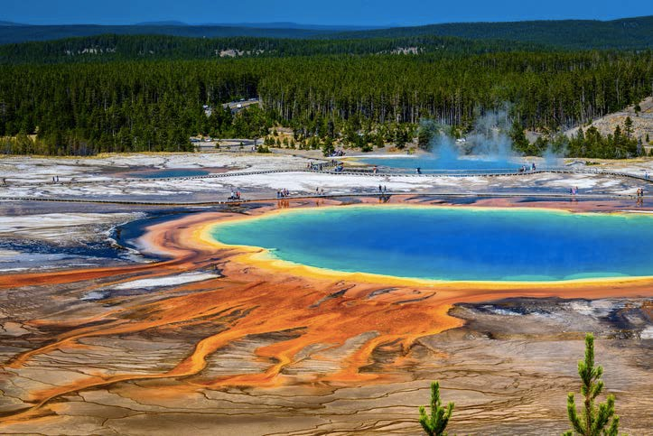
Grand Prismatic Spring – YNP – 183ºC
Validates the importance of microbes and sums up life on Earth with boundaries
Microbes are constantly trying to evolve and get deeper and deeper into the hot springs
Eukaryotes only surround this spring – cannot survive close to the hot spring

Slide 19
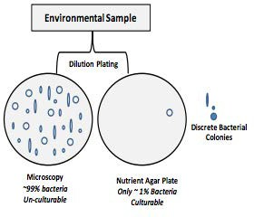
The great “plate count” anomaly
Cultivation based cell counts are orders of magnitude lower than direct microscopic observation
As microbiologists, we are able to cultivate only a small minority of naturally occurring microbes
Our nucleic acid derived understanding of microbial diversity has rapidly outpaced our ability to culture new microbes
IJSR, Sept 2013

Slide 20
Total number of genomes at NCBI
Number of genomes
250000
205698
200000
Haploid genome
Single circular chromosome, plasmids
Metabolic diversity
Genetic malleability
No nucleus
Easy interspecies gene transfer
150000
Number of genomes
100000
50000
30684
8583
16543
12254
0
Eukaryotes Prokaryotes
Viruses
Organism
Plasmids
Organelles
https://www.ncbi.nlm.nih.gov/genome/browse/#!/overview/

Slide 21
Roadmap to Culture Independent Techniques
1977: rRNA as an evolutionary marker (Woese and Fox, PNAS)
1985: Polymerase Chain Reaction (K. Mullis, Science)
1985: “Universal Primers” for rRNA sequencing (N. Pace, PNAS)
1989: PCR amplification of 16S rRNA gene (Bottger, FEMS Microbiol)
Early 1990’s: Curation and hosting of RDP (rRNA database) FTP
2001: Term ‘microbiome’ coined by Lederberg and McCray

Slide 22
Microbiomes and their significance
Microbes do not work or function as a single entity
Most microbial activities are performed by complex communities of microorganisms - microbiome

Slide 23
What is a microbiome
Totality of microbes in a defined environment, and their intricate interactions with each other and the surrounding environment
A population of a single species is a culture(monoculture), extremely rare outside of lab and in some infections
A microbiome is a mixed population of different microbial species
MIXED COMMUNITY IS THE NORM!

Slide 24
Why Study Microbiomes
Microbes modulate and maintain the atmosphere
Critical elemental cycles (carbon, nitrogen, sulfur, iron,…)
Pollution control, clean up fuel leaks
Microbes keep us healthy
Protection from pathogens
Absorption/production of nutrients in the gut
Role in chronic diseases (obesity, Crohn’s/IBD, arthritis…)
Microbes support plant growth and suppress plant disease
Most complex communities reside in soil
Crop productivity

Slide 25
Why is microbiome research new?
Bias for microbes (especially pathogens) that are cultivable
Culture-based methods do not detect majority of microbes
Only pathogens are easily detected
And most microbes are not pathogens
Availability of tools
Discovery of culture independent techniques
Amplicon sequencing and DNA sequencing

Slide 26
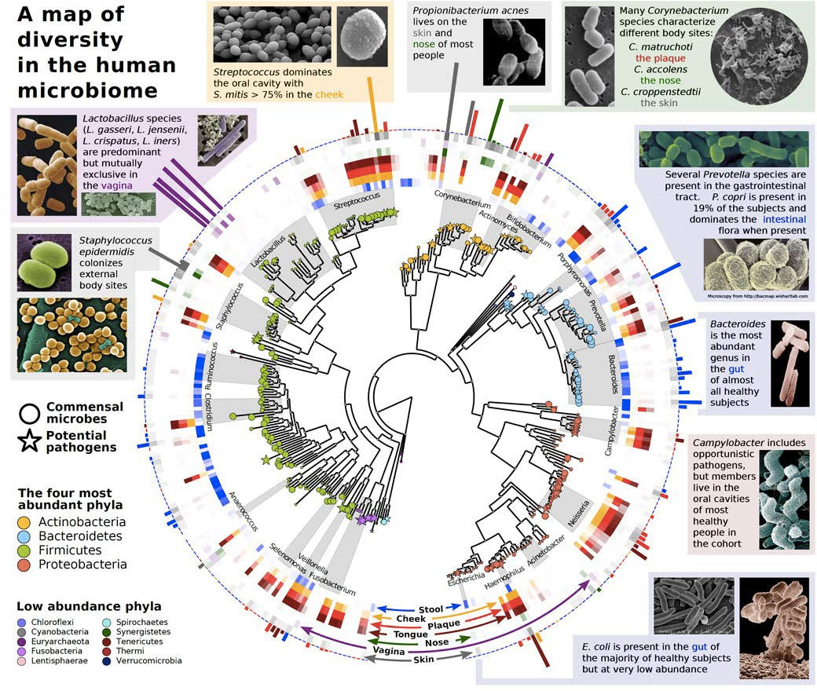
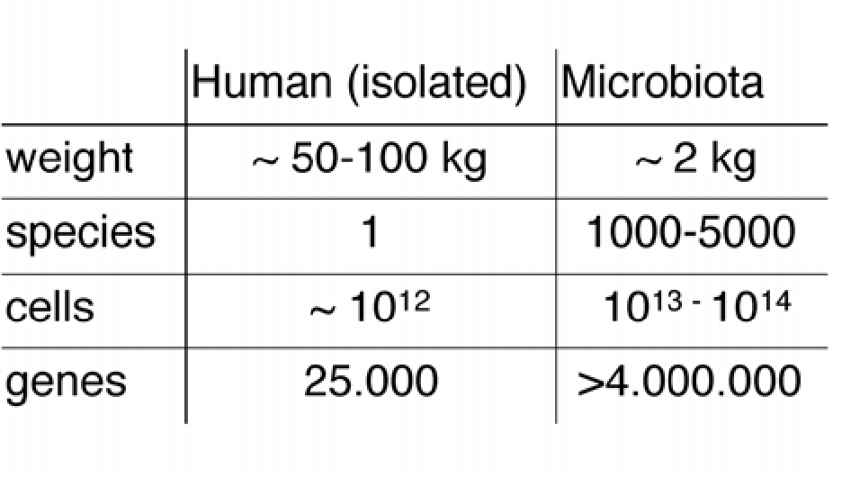
16S profiling
Trends in Genetics, 2013

Slide 27
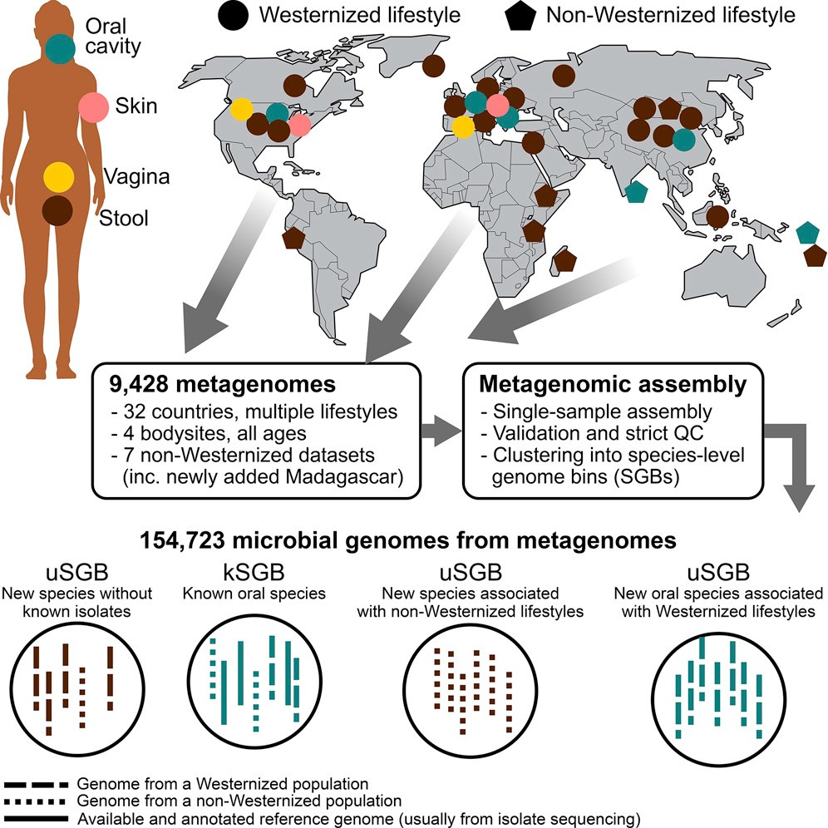
Cell, 2019

Slide 28
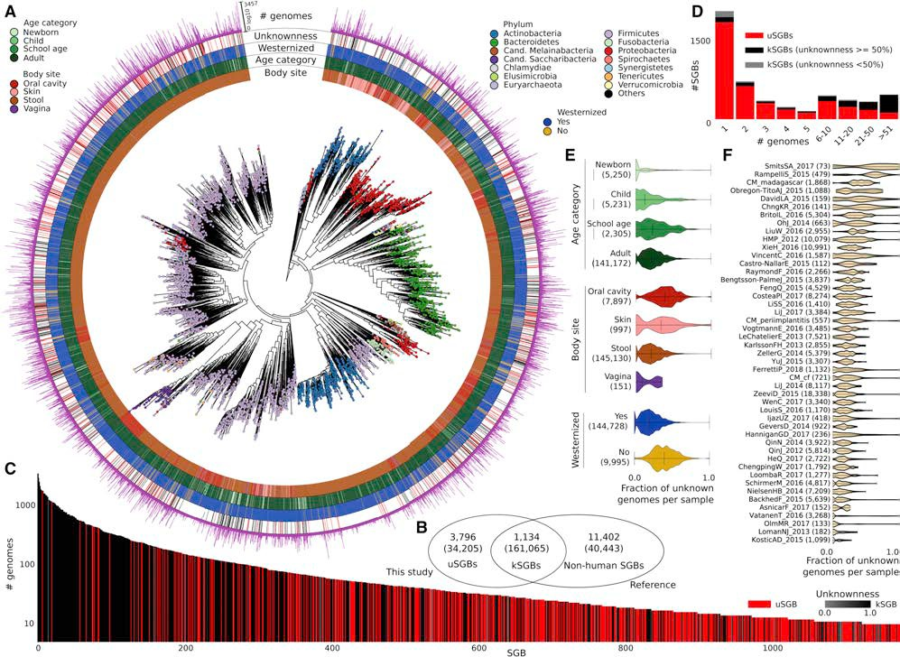
Recovered over 150,000 microbial genomes from
~10,000 metagenomes
70,178 genomes assembled with higher than 90% completeness
3,796 SGBs (species-level genome bins) identified -77% of the total representing species without any publicly available genomes
Cell, 2019

Slide 29
American Gut Project
Earth microbiome Project
Human Oral Microbiome Database
CardioBiome
Human Microbiome Studies – JCVI
MetaSub – Metagenomics and metadesign of Subways and Urban Biomes
Gut microbiota for Health
NASA: Study of the impact of long term space travel in the Astronaut’s microbiome
Michigan microbiome project
Coral microbiome project
Seagrass microbiome project
Brazilian microbiome project
Home microbiome study

Slide 30
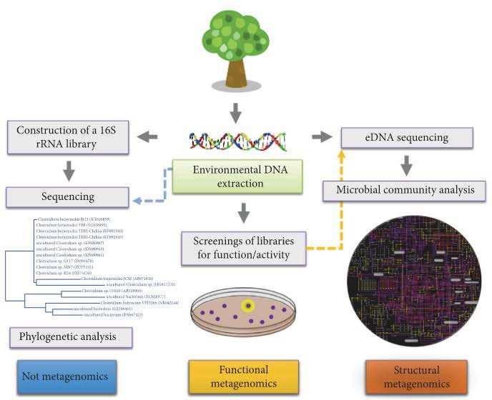
Structural and Functional Approaches to study microbiomes
International Journal of Genomics, 2018

Slide 31
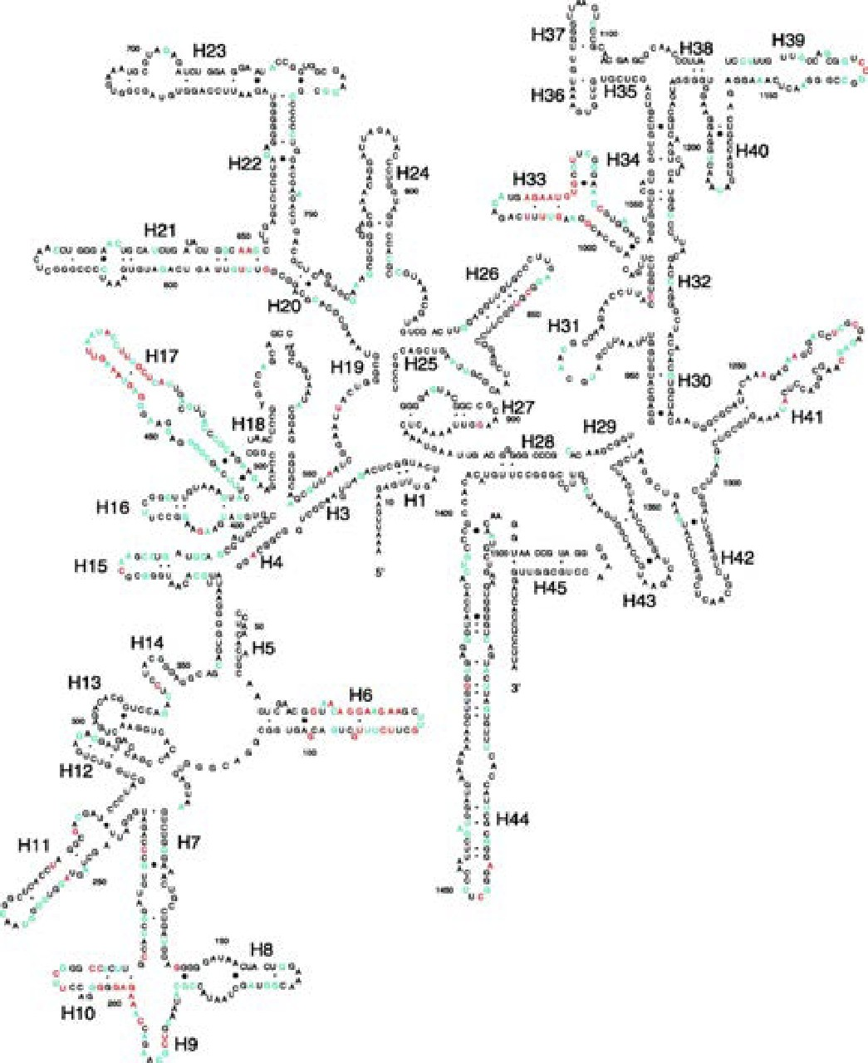
16S rRNA as an evolutionary chronometer
Ubiquitous – present in all known life (excluding viruses)
Functionally constant wrt translation and secondary structure
Evolves very slowly – mutations are extremely rare
Large enough to extract information for evolutionary inference
Limited exchange – limited examples of rRNA gene sharing between organisms
Kjellerberg et al, Microbial Ecology, 2007

Slide 32
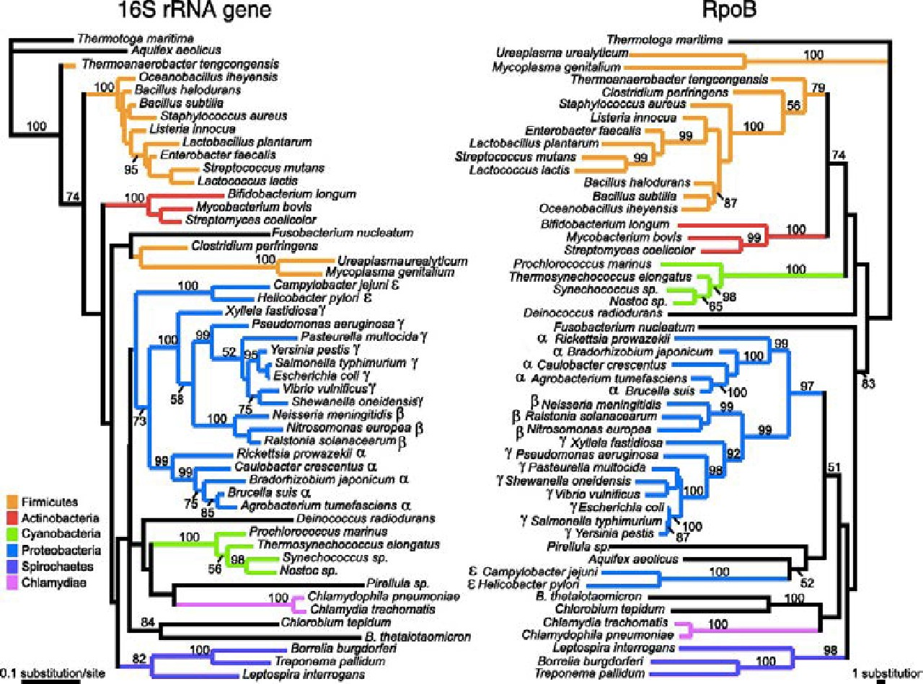
16S rRNA vs rpoB (RNA polymerase β subunit gene)
rpoB
Universal presence
Slow evolving
Housekeeping function
Large enough to contain phylogenetic information
Not conserved enough to be used as a marker gene
Kjellerberg et al, Microbial Ecology, 2007

Slide 33
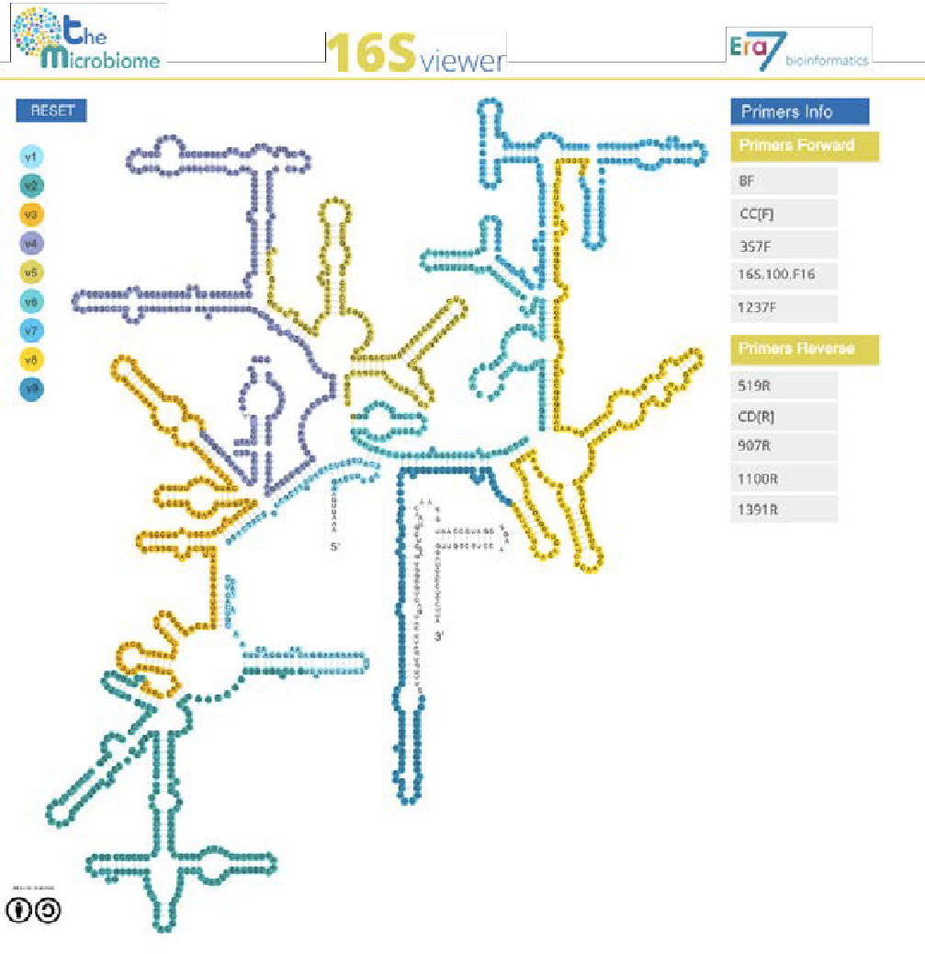
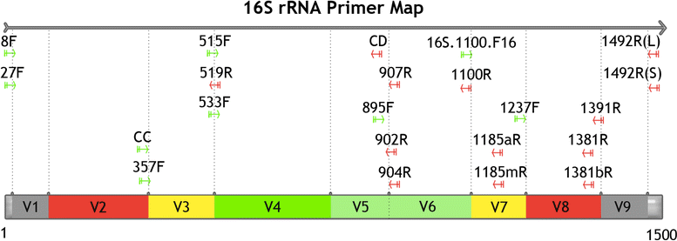
16S rRNA hypervariable regions
BMC Bioinf, 2016
Illustration of different hypervariable regions of 16S rRNA
Microbiome.com

Slide 34
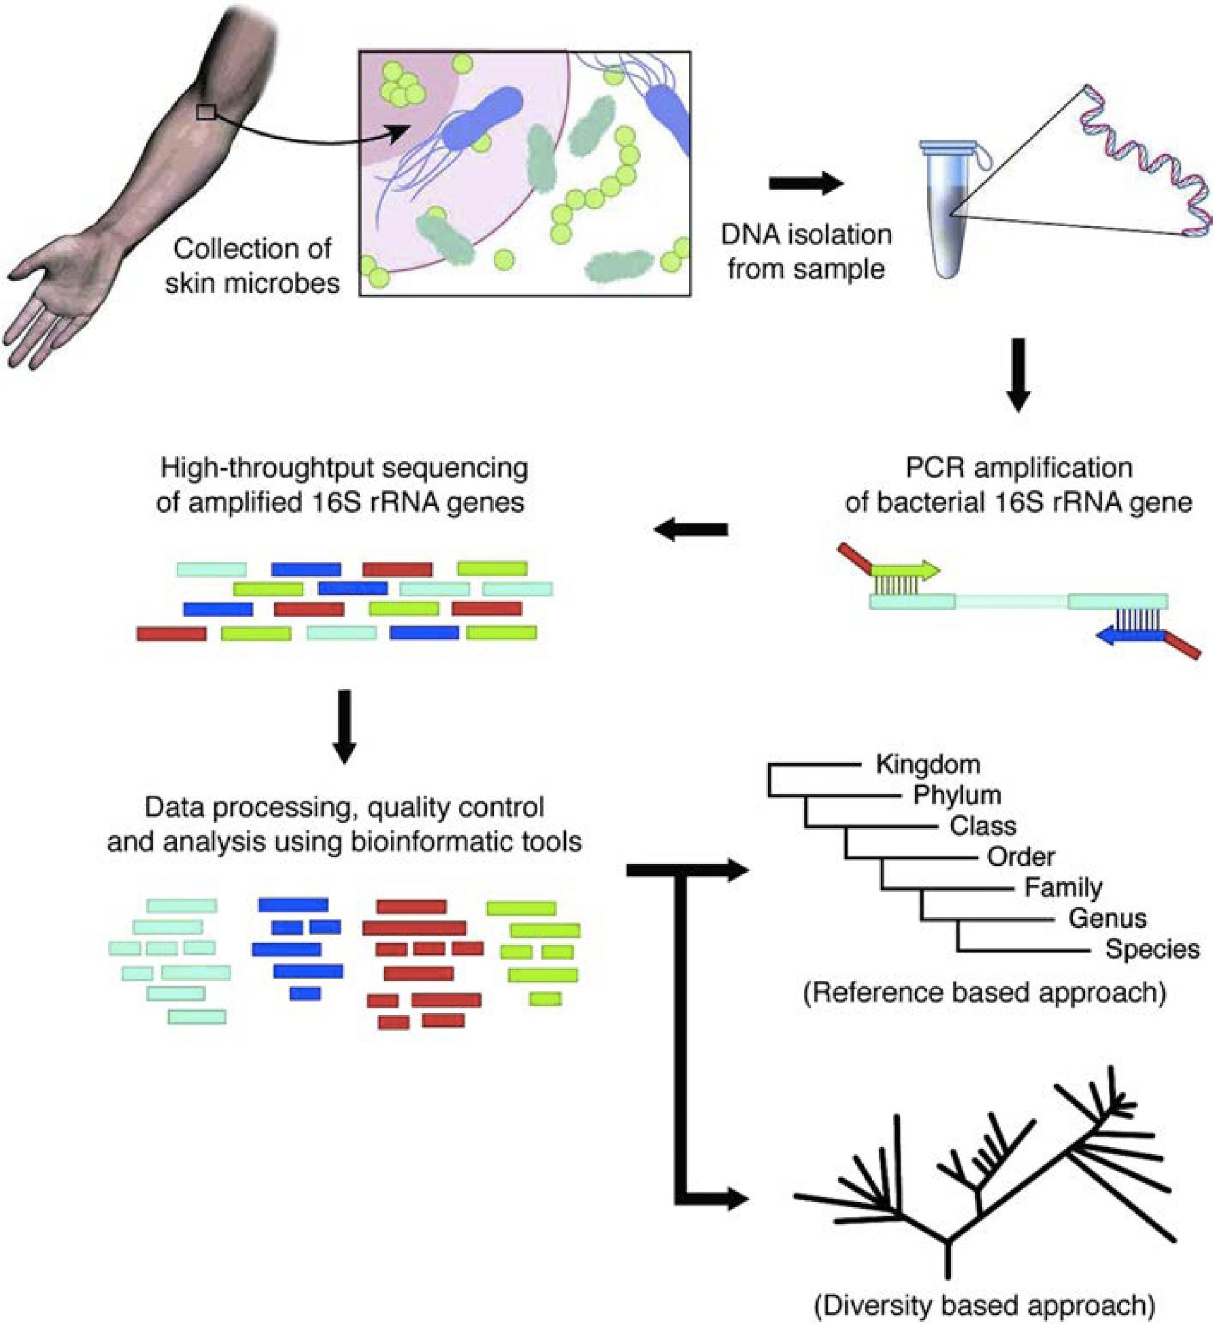
Basic Workflow for 16S Gene Based Sequencing
J. Investigative Dermatol, 2016

Slide 35
Addressing the ‘fine print’ while generating 16S rRNA gene amplicon libraries
Sample Collection
Sample collection significantly influences the microbiome profile after sequencing
Sample storage
DNA isolation
Template concentration
Template extraction protocol
PCR amplification
PCR bias and inhibitors
Amplification of contaminants
J. Microbiol Methods (2018), App. Environ. Microbiol. (2014), Microbiome (2015)

Slide 36
Steps Involved
Experimental Design: How many samples can be included in the sequencing run?
By using barcoded primers, numerous samples can be sequenced simultaneously (multiplexing)
Sequencing adapter
F
V4 region
Sample ID | Barcode
AB123_newborn | GAACCAAAGGAT
AB121_one_month | TACACGATCTAC
AB_145_two_months | GCGATATATCGC
AB_134_birth | CAGTGCATATGC
AB_189_birth | TCCAAAGTGTTC
AB_170_birth | GGCCACGTAGTA
R
barcode
Sequencing adapter

Slide 37
Samples
More the number of samples, more cost effective the run (sequencing depth will be compromised)
Comparison of multiplexing capacity by sequencing system
Illumina.com
It is critical to have a ‘library prep manifest’ to document the position of each sample with its associated barcode along with additional metadata information

Slide 38
Include Controls
Between run repeat (process any sample in duplicate per run to measure reproducibility across runs)
Within run repeat (process any sample in duplicate per plate to measure reproducibility)
Water used during PCR (water blank- to determine if any contaminant was introduced during PCR reaction)
Water spiked with known bacterial DNA (mock bacterial communities- enables quantification of sequencing errors, minimizes bias during sampling and library preparation )

Slide 39
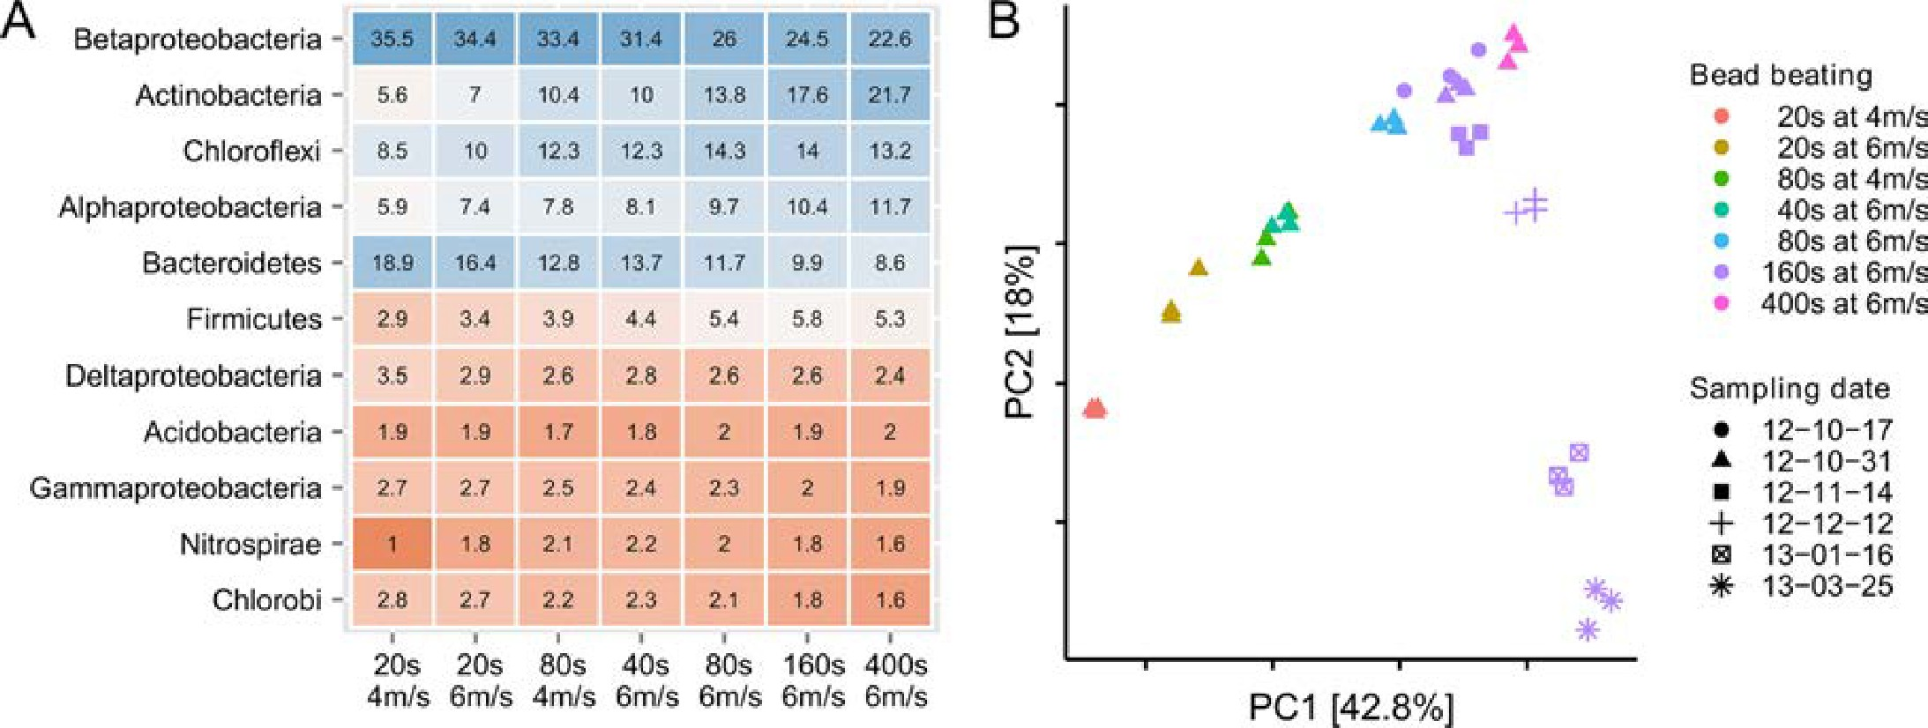
DNA extraction protocol
Effect of mechanical lysis methods for extraction
Presence of inhibitors such as organic matter, humic acid, bile salts, polysaccharides
DNA yield post extraction and reproducibility
Effect of bead beating was larger than sampling time over 5 months
PLOS One, 2015
Percentage read abundance of the 11 most abundant phyla as a result of bead beating intensity
PCA of samples with different bead beating intensities vs. samples taken at different dates

Slide 40
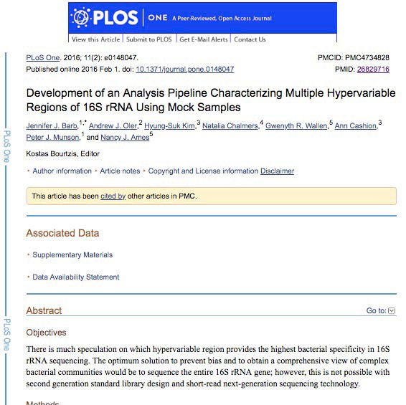
Selection of primers and region of 16S gene influence microbial profile
V2, V4, V6-V7 regions produced consistent results

Slide 41
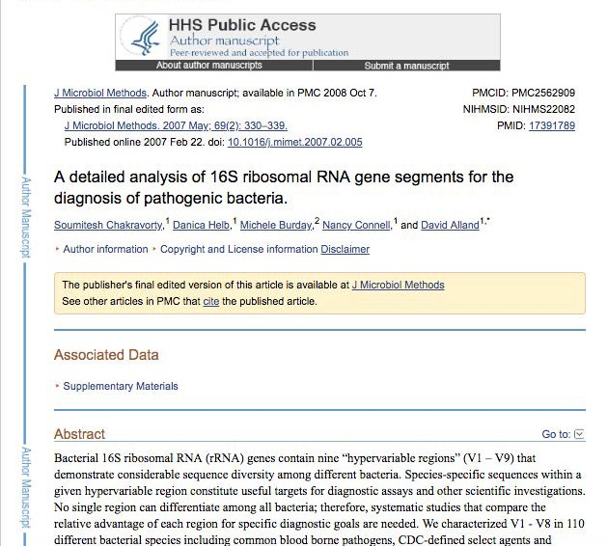
V2, V3 and V6 contain maximum nucleotide heterogeneity
V6 is the shortest hypervariable region
with the maximum sequence heterogeneity
V1 is best target for distinguishing pathogenic S aureus
V2 and V3 are excellent targets for
speciation among Staph and Strep pathogens as well as Clostridium and Neisseria species
V2 especially useful for speciation of
Mycobacterium sp. and detection of E coli O157:H7
V3 useful for speciation of
Haemophilus sp
V6 best target for probe based PCR assays to identify CDC select agents
(bio-terrorism agents)

Slide 42
Purification of amplicons
After one –step or two-step PCR, products are cleaned up using AMpure beads

Slide 43
Gel Electrophoresis and quantification of cleaned amplicon products
Qubit
Sample pooling – equimolar concentrations (how many samples do you want to pool? How many reads per sample?
Gel extraction of pooled product
Final clean up (Qiagen kit) and QC

Slide 44
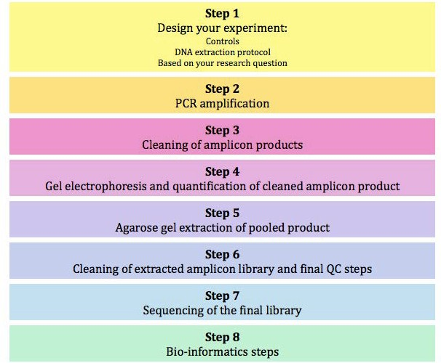
Summary of 16S rRNA library prep steps

Slide 45
Amplicon Sequencing Library Prep- PacBio

Slide 46
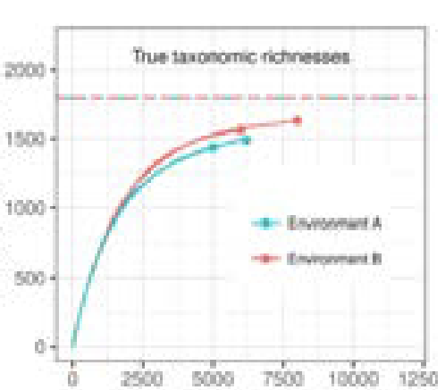
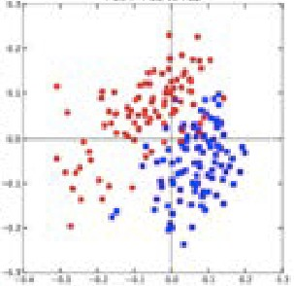
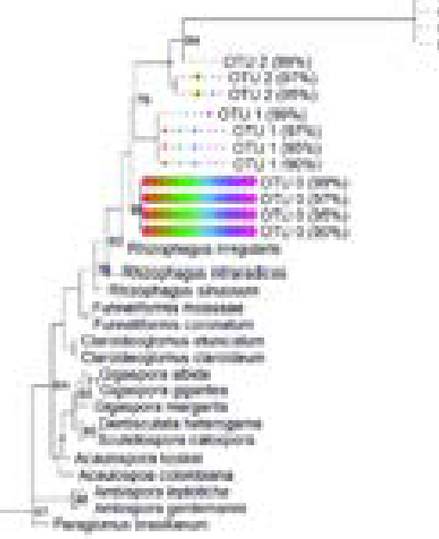
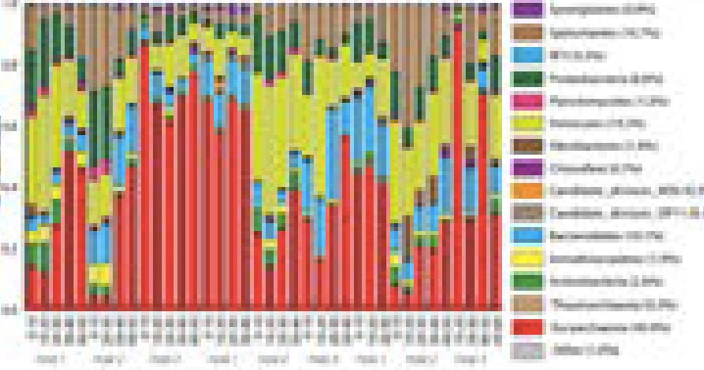
Overview of generic amplicon workflow
Sequencing facility
Fastq files
demultiplex
Fastx_demux, fastx-toolkit
Generate
OTUs
Quality filter/trim
Trimmomatic cutadapt
Fasta files
 | Sample1 | Sample B | …
Seq_1 | 0 | 400 | …
Seq_2 | 305 | 350 | …
Seq_3 | 200 | 1 | …
… | … | … | …
Count table Fasta file taxonomy
Chimera removal
dereplication
Resolve ASVs
Analysis
For this workshop, QIIME2
MOTHUR
Alpha diversity Beta diveristy
Taxonomic summaries Phylogeny

Slide 47
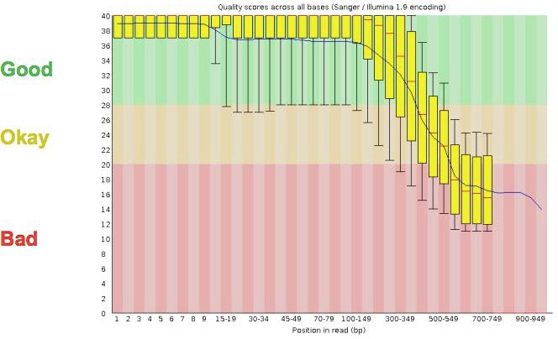
Data Preprocessing
FastQC
Many tools/options to filter and trim data
Trimming does not always improve things as valuable information can be lost!
Removal of adapters is critical for downstream analysis

Slide 48
Dereplication
In this process all the quality-filtered sequences are collapsed into a set of unique reads, which are then clustered into OTUs
Dereplication step significantly reduces computation time by eliminating redundant sequences

Slide 49
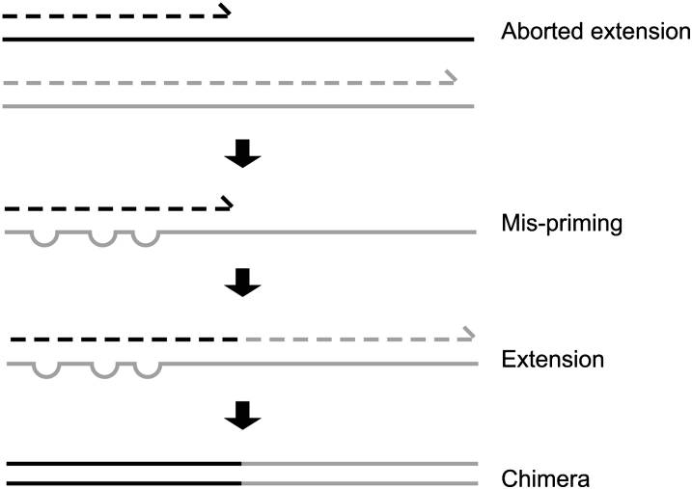
Chimera detection and removal of non-bacterial sequences
Chimeras as artifact sequences formed by two or more biological sequences incorrectly joined together
Incomplete extensions during PCR allow subsequent PCR cycles to use a partially extended strand to bind to the template of a different, but similar, sequence. This partially extended strand then acts as a primer to extend and form a chimeric sequence.
Genome Research, 2011

Slide 50
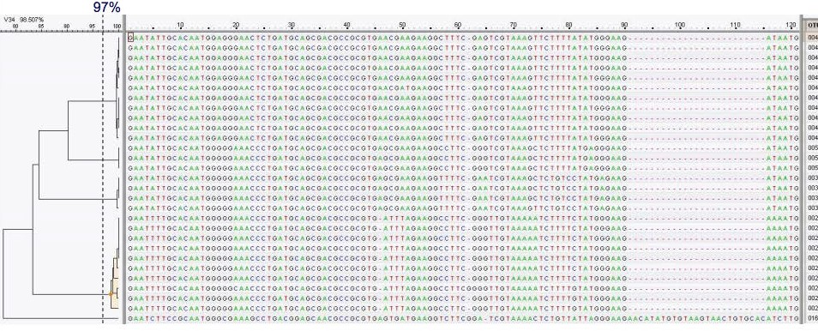
Clustering
Analysis of 16S rRNA relies on clustering of related sequences at a particular level of identity and counting the representatives of each cluster
Some level of sequence divergence should be allowed – 95% (genus-level, partial 16S gene), 97% (species-level) or 99% typical similarity cutoffs used in practice and the resulting cluster of nearly identical tags (assumedly identical genomes) is referred to as an OTU (Operational Taxonomic Unit)

Slide 51
Create OTU tables
OTU table is a matrix that gives the number of reads per sample per OTU

Slide 52
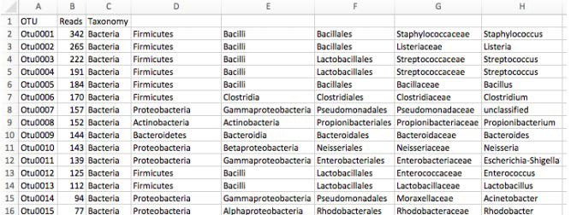
Bin OTUs into Taxonomy (assign taxonomy)
Accuracy of assigning taxonomy depends on the reference database chosen
Ribosomal Database Project
GreenGenes
SILVA
Accuracy depends on the completeness of databases

Slide 53
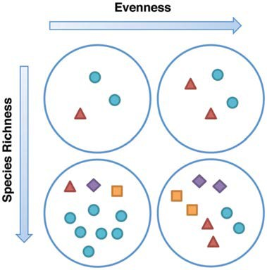
Population diversity – alpha diversity
Assessment of diversity involves two aspects
Species richness (# of species present in a sample)
Species evenness (distribution of relative abundance of species)
Total community diversity of a single sample/environment is given by alpha-diversity and represented using rarefaction curves
Quantitative methods such as Shannon or Simpson indices measure evenness of the alpha- diversity
Human Mol. Genet., 2013

Slide 54
Beta-diversity
Beta-diversity measures community structure differences (taxon composition and relative abundance) between two or more samples
For example, beta-diversity indices can compare similarities and differences in microbial communities in healthy and diseases states
Many qualitative (presence/absence taxa) and quantitative(taxon abundance) measures of community distance are available using several tools
LIBHUFF, TreeClimber, DPCoA, UniFrac (QIIME)

Slide 55
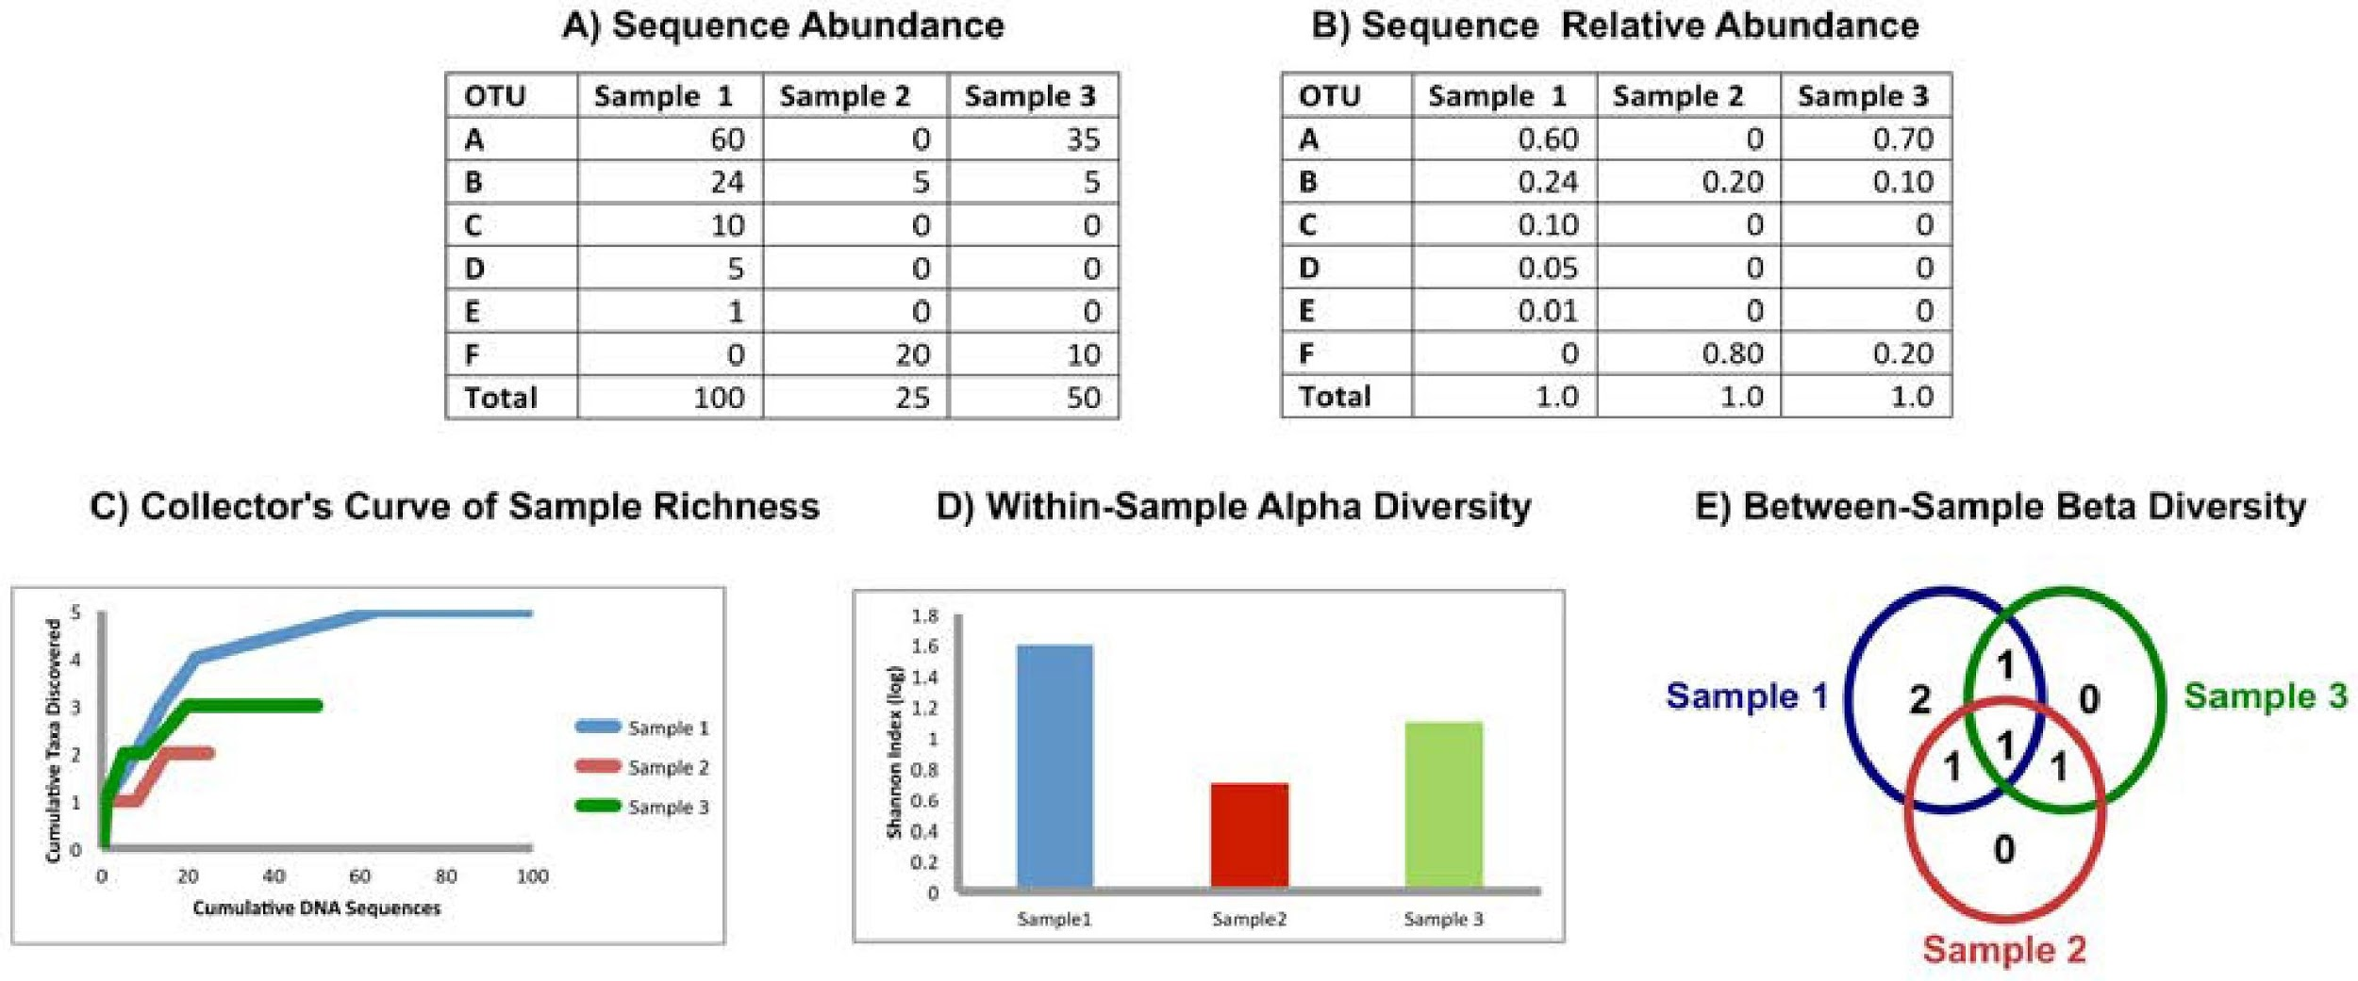
Measuring Population Diversity – alpha and beta diversity
PLoS Computational Biol.,2012

Slide 56
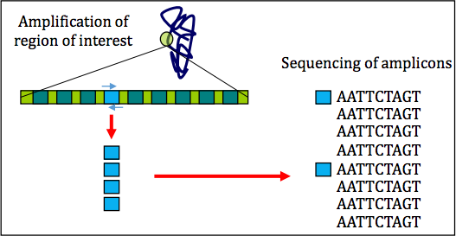
16S rRNA sequencing – benefits and limitations
Benefits
Cost effective
Data analysis can be performed by established pipelines
Large body of archived data is available for reference
Limitations
Sequences only a single region of the genome
Classifications often lack accuracy at the species level
Copy number per genome can vary. While they
tend to be taxon specific, variation among strains is possible
Relative abundance measurements are unreliable because of amplification biases
Diversity of the gene tends to overinflate
diversity estimates

Slide 57
FastQC for 16S rRNA dataset
Extremely biased per base sequence content
Extremely narrow distribution of GC content
Very high sequence duplication levels
Abundance of overrepresented sequences
In cases where the PCR target is shorter than the read length, the sequence will read through into adapters

Slide 58
QIIME -2
Importing data
Demultiplexing
Running Quality Control
Creating a feature table
Building a phylogenetic tree
Calculating core diversity metrics
Testing alpha diversity group significance and correlation
Performing beta diversity ordination
Testing beta diversity group significance
Assigning taxonomies
Performing differential abundance analysis with ANCOM and/or gneiss

Slide 59
Taxonomy: Expectation vs Reality
Kingdom – Bacteria Phylum - Proteobacteria
Class - Gammaproteobacteria
Order - Enterobacteriales Family - Enterobacteriaceae Genus – Escherichia Species – coli
Strain - 0157:H7
-----
OTU 2445338

Slide 60
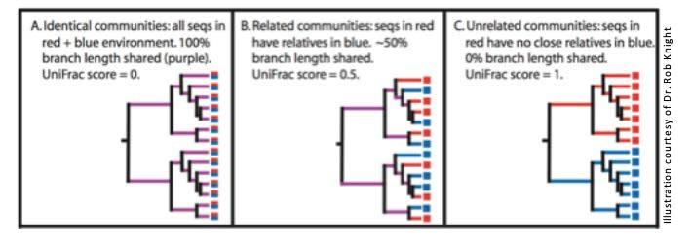
Beta Diversity - UniFrac
Measures how different two samples’ component sequences are
Weighted Unifrac: takes abundance of each sequence into account

Slide 61
Results from paper
Main phyla: Firmicutes, Bacteroidetes, Proteobacteria, Actinobacteria, Fusobacteria with differences bw samples
Sputum (patient) samples had highest diversity followed by oropharynx samples followed by nasal
Healthy controls (N and O) more diverse than samples from TB patients
Between-group comparisons?
Phyla differences?

